Slide 1
Azure + Terraform
https://aka.ms/learn-tf

Slide 2
Software Innovation Collision
Containers
(Standardization of the application packaging)
DevOps
(Optimizing how applications are build, delivered and Managed)
Microservices
(Optimizing how applications are composed)
Better Software
Kubernetes Orchestration
(Efficient ways to deliver Infrastructure for Applications)

Slide 3
Terraform Overview
Notes:
There is more….
3. Power BI Desktop is a visual data exploration tool that enables you to analyze data and create stunning reports. With Power BI Desktop, you are able to:
Acquire and prepare data using extensive query capabilities.
Manipulation and consolidation of multiple data sources is performed in Power BI Desktop – this enables Power BI service users to use data from multiple sources in a single report.
Establish data structure, then transform and analyze data.
Visualize and explore your data in new ways through a freeform drag-and-drop canvas.
Author reports with a broad range of modern data visualizations.
Publish beautiful, interactive reports directly to powerbi.com.
Securely share reports through unique, curated content library approach.
4. Finally, the Power BI Platform allows you to embed, extend, and integrate Power BI into other applications and environments.

Slide 4
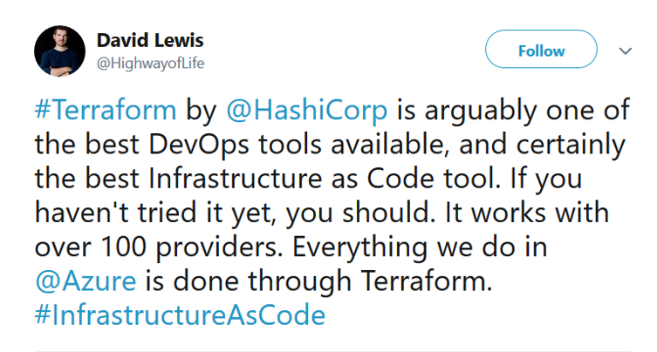

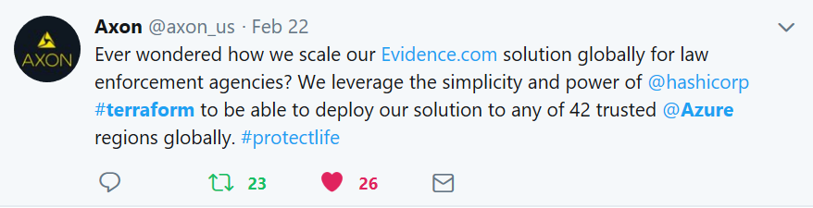

Terraform + Azure

Slide 5








Terraform + Azure

Slide 6
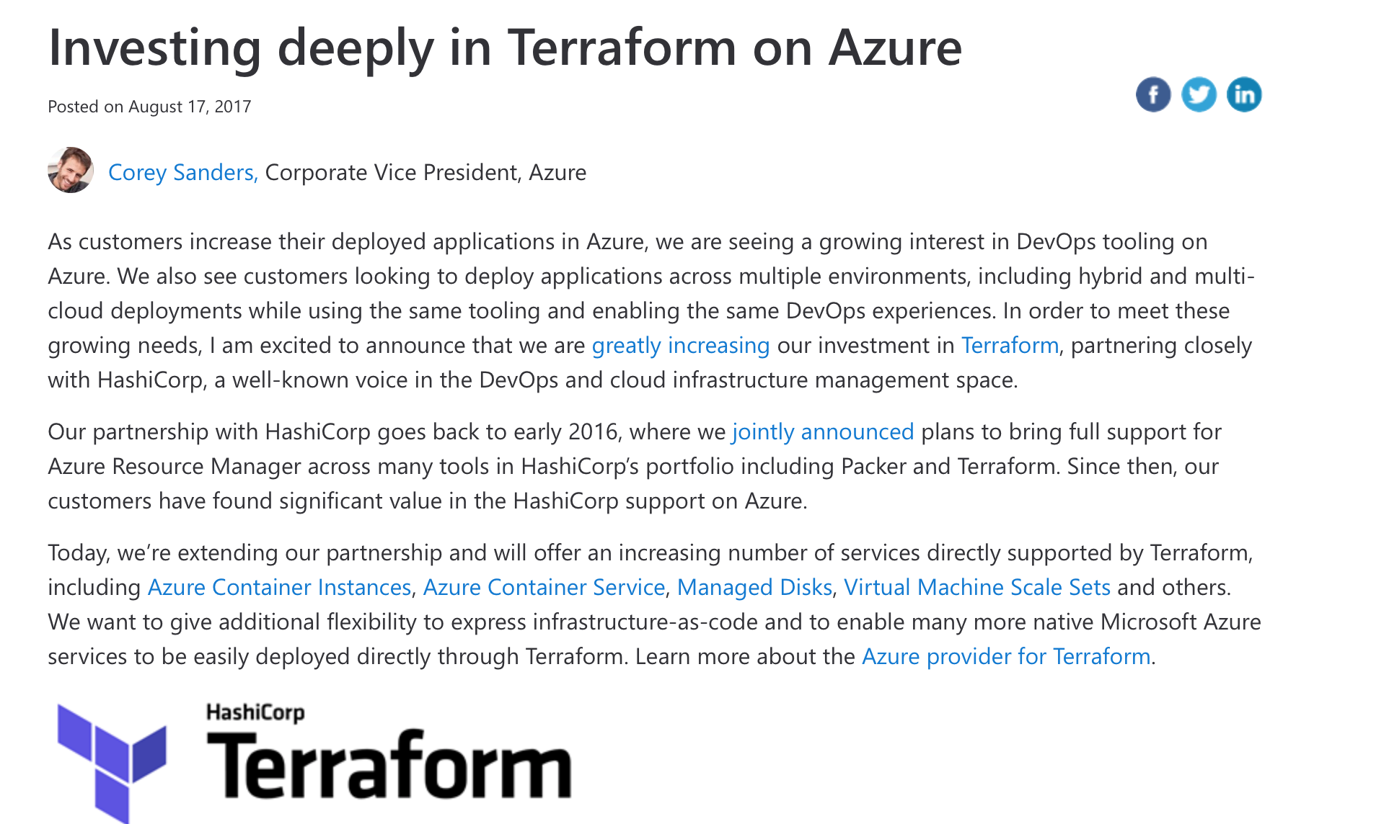
HashiCorp Partnership

Slide 7
HashiCorp Partnership
Multi-year agreement with HashiCorp where we jointly work on Terraform provider for Azure
Work is divided into milestones
Tracked publicly in GitHub at
http://github.com/terraform-providers/terraform-provider-azurerm
Labeled M1-M5, you might have seen this in labels on github.com
Dedicated (small) Azure engineering team
Microsoft FTEs
Part-time SI/vendors

Slide 8
Terraform Positioning
Basic idea: ”meet customers where they are at”
DevOps OSS toolchain is excellent, but so is Azure DevOps offerings
Many customers/industries have already adopted a set of DevOps best practices in “other” clouds
Ensure customers are successful in our cloud

Slide 9
Case Study 1: Axon
Publicly Available at https://customers.microsoft.com/en-us/story/axon-professional-services-azure
AWS to Azure Migration
20 petabytes of data migrated, growing at 2 petabytes/month
Migrated to Azure in 2017
We were just getting going with Terraform in Azure :)
IaaS migration: storage mostly, but also compute and networking
Key success factors
Working with CSAs to jump ahead of customer needs
Empowering others to enhance Terraform provider and docs
“We don’t have to build each new environment from scratch. What used to take several weeks, we can do with Terraform in a few hours.”

Slide 10
Links to Terraform Resources
Microsoft
https://azure.microsoft.com/en-us/solutions/devops/terraform/
https://aka.ms/tfhub
HashiCorp
https://www.terraform.io/docs/providers/azurerm/index.html
https://github.com/terraform-providers/terraform-provider-azurerm

Slide 11
Infrastructure as Code
Reproducible Environments
Automation – CI/ CD
Trackable – GitHub
Language - HCL
Workflow
Providers
Apply same config across clouds
Notes:
Benefits of IaC

Slide 12
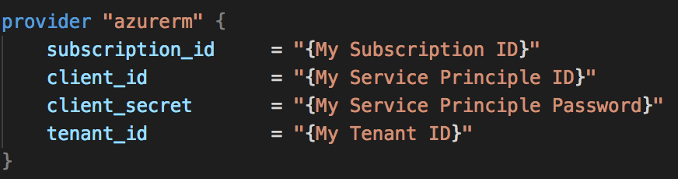
Azure Provider
Authentication
Azure CLI
Service Principal
MSI
Arguments
Environment Variables

Slide 13
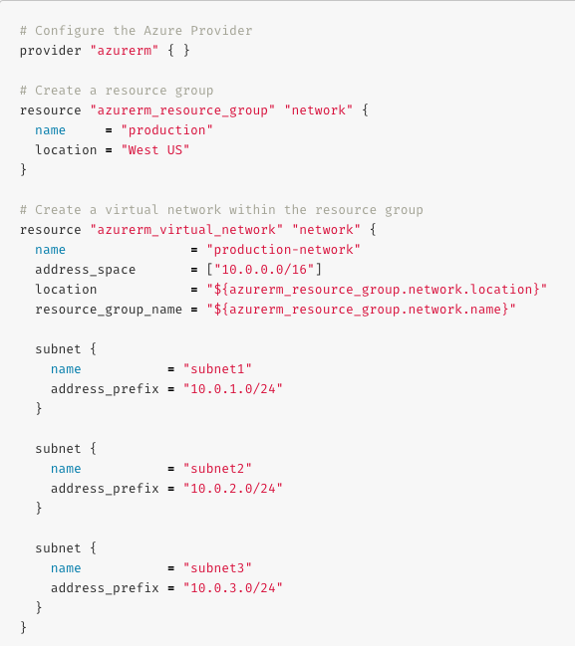
Azure Resources & Datasources
Provisioning for Azure IaaS
Compute (VMSS, Disk, Image, Snapshot, …)
Networking (Vnet, LB, DNS, …)
Azure Active Directory
Database (MySQL, PostgreSQL, SQL)
Monitoring
Storage (Storage Account, Blob, Share, …)
…
Provisioning for Azure PaaS
Containers (AKS, ACI)
Web Apps
CosmosDB
Data Lake
Logic Apps
KeyVault
…
Catch-All
ARM Template
Notes:
Where is Azure in terms of resources and datasources for azure? IaaS ~100%, PaaS Good and getting better, ARM template fallback

Slide 14
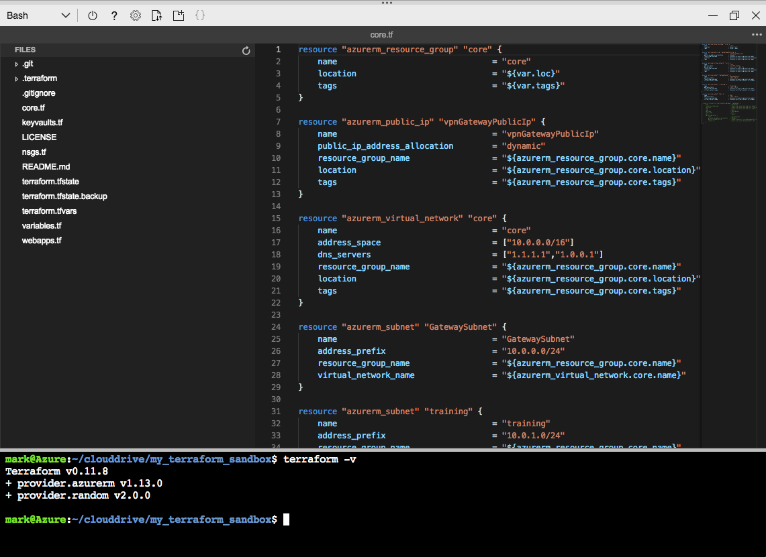
Assembly
Cloud Shell
Terraform integration
Editor with Terraform Syntax Highlighting
Visual Studio Code
Terraform extension
Azure Terraform extension
Notes:
Azure Terraform
Terraform command support, resource graph visualization and CloudShell integration inside VSCode.
Terraform
Syntax highlighting, linting, formatting, and validation

Slide 15
Workflow
Init
Plan
Apply
Destroy
Notes:
Opinionated
Init – installs required resources, modules and providers
some validation
Backend
run 1 time unless upgrade
Plan - Refresh state
Actions needed
Apply - enacts plan
Destroy - removes resources in plan

Slide 16
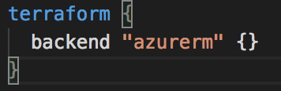
Azurerm backend
Standard Backend with state locking & consistency checking
Azure Storage (Blob)
remote-state.tf .backend.tfvars
Notes:
Stores the state as a given key in a given blob container on Microsoft Azure Storage. This backend also supports state locking and consistency checking via native capabilities of Microsoft Azure Storage.

Slide 17
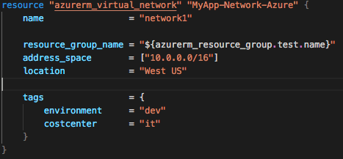
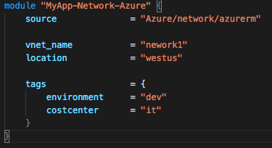
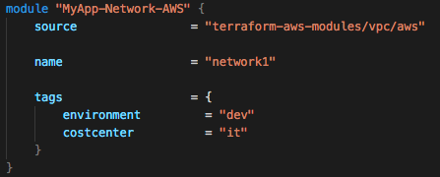
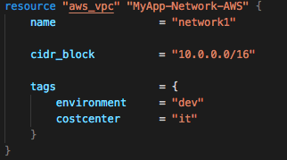
Modules

Slide 18
Thank you.

